Slide 1
Civic-Minded Graduate: Construct Validation Evidence
Robert G. Bringle (rbringle@iupui.edu)
Thomas W. Hahn (tomhahn@iupui.edu)
Julie A. Hatcher (jhatcher@iupui.edu)
IUPUI Center for Service and Learning
IARSLCE Annual Conference
November 16-18, 2015

Slide 2
Overview
Civic Engagement
Civic-Minded Graduate (CMG)
CMG Scale, Narrative and Rubric
Four validation studies
Implications for research and practice

Slide 3
IUPUI: Centralized Support Centers
Center for Teaching and Learning
Center for Research and Learning
Center for Service and Learning
Notes:
IUPUI has developed 3 centralized support centers; in addition to CSL—there’s also a center for T & L and R & L.
We aren’t the Center for SL—but service and learning = a broad charge for service

Slide 4
IUPUI Center for Service & Learning
Office of Service Learning
curricular
Office of Community Service—joint with student affairs
voluntary service
Office of Community Work Study—joint with career center
community-service employment

Slide 5
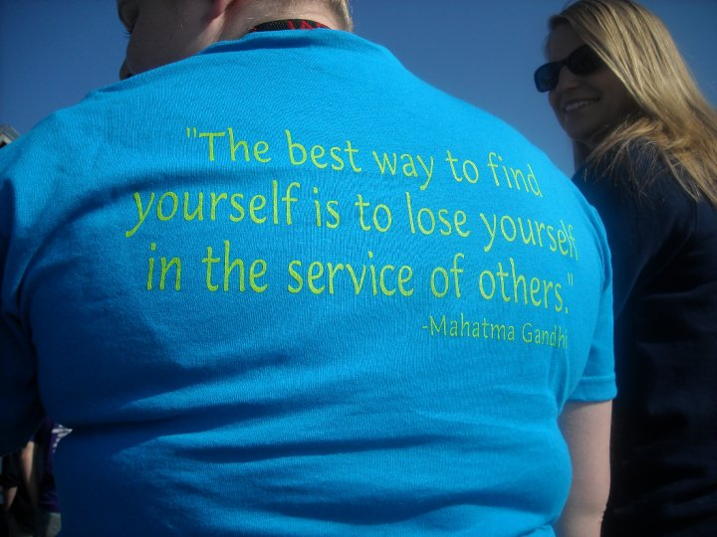
A Fundamental Question:
What is educationally-meaningful service?
Notes:
This is the question that the CSL considered for several years→ what are the common outcomes to all or most of our civic engagement activities?

Slide 6
Working Definition of Civic-Minded Graduate
A civic-minded graduate is one who
is formally educated and
has the capacity and orientation to work with others
in a democratic way
to improve communities.

Slide 7
Knowledge:
• Volunteer opportunities: understanding of ways to contribute to society, particularly through voluntary service, and including knowledge of nonprofit organizations.
• Academic knowledge and technical skills: understanding of how knowledge and skills in at least one discipline are relevant to addressing the issues in society.
• Contemporary social issues: understanding of current events and the complexity of issues in modern society locally, nationally, or globally.
Skills:
• Communication and listening: ability to communicate (written and oral) with others, as well as listening to divergent points of view.
• Diversity: understanding the importance of, and the ability to work with, others from diverse backgrounds; also appreciation of and sensitivity to diversity in a pluralistic society.
• Consensus building: ability to work with others, including those with diverse opinions, and work across difference to come to an agreement or solve a problem.
Attitudes/Dispositions:
• Valuing community engagement: understanding the importance of serving others, and being actively involved in communities to address social issues.
• Self-efficacy: having a desire to take personal action, with a realistic view that the action will produce the desired results.
• Social trustee of knowledge: feeling a sense of responsibility and commitment to use the knowledge gained in higher education to serve others.
Behavioral Intentions:
A stated intention to be personally involved in community service in the future
Notes:
talk about the origin of this (“educationally meaningful service”) and the breadth of application (all SL courses + co-curricular)

Slide 8
Civic-Minded Graduates
Identity
Civic Experiences
Educational Experiences
Civic-Minded Graduate (CMG)
1
3
2
Cultural Norms and Social Context

Slide 9
Sample Student A
Personal
Identity
Educational Experiences
Civic
Experiences
Notes:
Student who is active in the community (e.g., politics, church), and interested in education, buth the academic and civic are independent.

Slide 10
Sample Student B
Personal
Identity
Educational Experiences
Civic
Experiences
Notes:
Student who is enrolled in a SL course, but it doesn’t mean anything to the student.

Slide 11
Norris, 2011
Potential Factors Influencing Civic-Mindedness
Mentored Relationships
Service Learning w/ Reflection
Personal
Identity
Educational Experiences
Civic
Experiences
Dialogue Across Difference
Prior Experiences
Notes:
What are the factors that we think increase overlap and drive the triple intersection?

Slide 12
Assessment: CMG Scale
30-item self-report measuring knowledge, skills, dispositions, and behavioral intentions
Paper, online administration
Adaptable: course, major, or “My education at IUPUI” – depends on the research question
Notes:
Multiple assessment procedures for CMG→ 1st: self-report

Slide 13
Assessment: CMG Narrative and Rubric
Prompt: I have a responsibility and a commitment to use the knowledge and skills I have gained as a college student to collaborate with others, who may be different from me, to help address issues in society.
Notes:
2nd

Slide 14
Assessment: CMG Interview and Rubric
Types of community involvement
Motives
Identity
Future involvement
Problem situation
Notes:
3rd

Slide 15
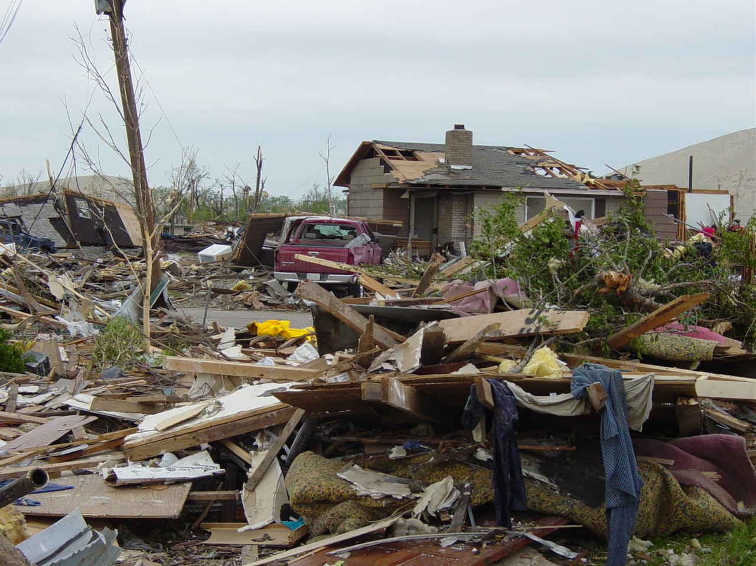
Problem Situation
How might you be involved?
Imagine that Indiana is hit by a series of major tornados, floods or another natural or man-made disaster (similar to the devastation seen with Hurricane Katrina). You and your family all survive and your residence is not destroyed, but many other people have died or are displaced, and many homes, businesses, and schools are destroyed. There is a general sense of panic in the community. The mayor of your community is able to address the public through radio and television and has asked that people join together in this time of need.
How has your education contributed to knowledge and skills that might be useful?
Notes:
4th: although we haven’t used this yet.

Slide 16
CMG Validity Study—MJCSL, 2011
Sample (N = 606) of IUPUI undergraduates completed CMG Scale and Narrative Prompt (N = 397)
Subsample (N=41) completed CMG Interview
Out of this subsample, 29 completed the Narrative Prompt
Morton’s Integrity Scale—integration of community service with self
Social Desirability
# of courses with community involvement

Slide 17
Results
CMG Scale
Reliability: Chronbach’s alpha = .96
Construct Validity: 1 factor, 49.4% of variance
Number of courses taken with community involvement was associated with CMG scores
r = .34, p < .01

Slide 18
Results
Interview Ratings
N = 41
Good inter-rater reliability (intra-class): r=.95
Established convergent validity with CMG Survey
r = .49, p < .01

Slide 19
Results
Narrative Ratings
N = 29 (out of 41 who completed both survey and interview)
Inter-rater reliability (intra-class): r = .86
Narrative ratings correlated significantly with CMG Survey scores, r = .45, p < .01, but not Interview ratings, r = .31, p > .05

Slide 20
Overall, CMG Survey, Narrative, and Interview all showed good reliability
Converging evidence on all three measurement procedures establishes validity for Civic Minded Graduate
CMG Scale not correlated with Social Desirability, r = .13, p > .05.
CMG correlated with the Integrity with which persons do service, r = .32, p < .05.

Slide 21
Study 2 (2013): Purpose
Integration of the self with the identity of being a student with CMG
Integration of the self with civic identity with CMG
Further construct validation of CMG scale

Slide 22
Methods
Participants (n = 132) were from ASU
Questionnaire
Student Identity (6 items)
“Many people think of me as being a student.”
“It is important to me that I continue my education.”
Civic Identity (7 items)
“I would feel a loss if I were to stop involving myself in their community.”
“The people I know think that community involvement is important to me.”

Slide 23
Methods (cont.)
Questionnaire
Civic-Minded Graduate Scale
Volunteer Functions Inventory (VFI)—Clary & Snyder: Protective, Values, Career, Social Understanding, Enhancement
Morton Typology: Charity, Programs, Advocacy

Slide 24
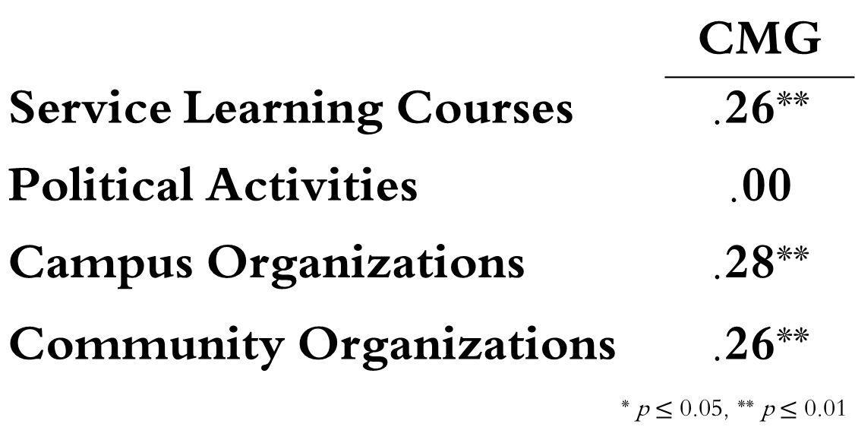
Bivariate Correlations
 | CMG
Service Learning Courses | .26**
Political Activities | .00
Campus Organizations | .28**
Community Organizations | .26**
* p $≤$ 0.05, ** p $≤$ 0.01

Slide 25
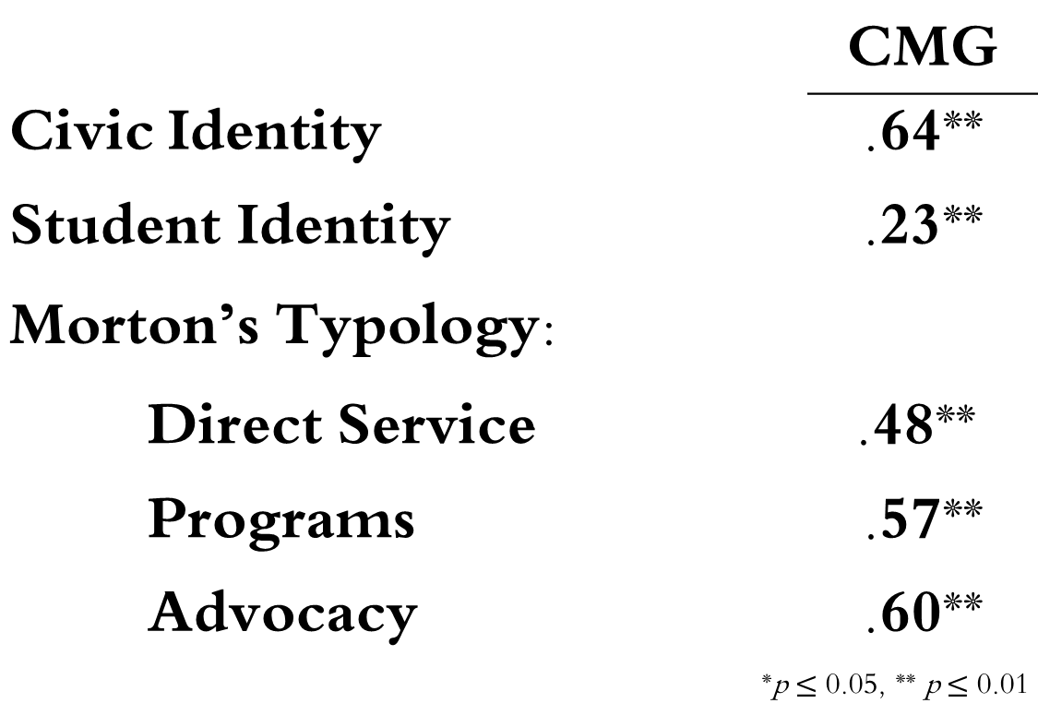
Bivariate Correlations
 | CMG
Civic Identity | .64**
Student Identity | .23**
Morton’s Typology:
Direct Service | .48**
Programs | .57**
Advocacy | .60**
*p $≤$ 0.05, ** p $≤$ 0.01

Slide 26
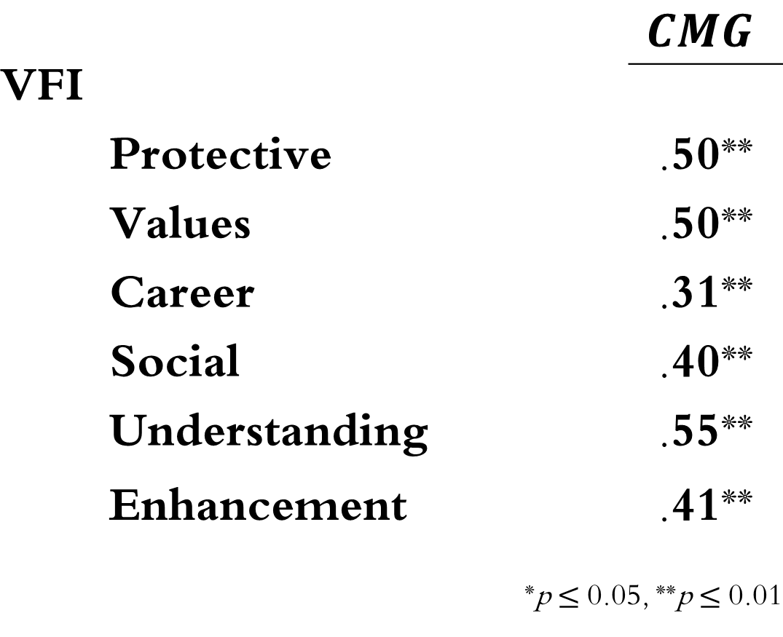
Bivariate Correlations
 | $$CMG$$
VFI
Protective | .50**
Values | .50**
Career | .31**
Social | .40**
Understanding | .55**
Enhancement | .41**
*p $≤$ 0.05, **p $≤$ 0.01

Slide 27
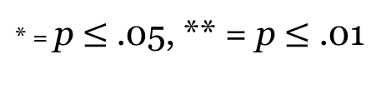
Stepwise Multiple Regression DV: CMG
VFI-Understanding cum R =.76**
Civic Identity R = .64**
Advocacy cum R = .74**
* = p $≤$ .05, ** = p $≤$ .01

Slide 28
Study 3 (2014): Purpose
Extend the construct validation of CMG to other components implied by the conceptual framework

Slide 29
Methods
Participants (n = 182) were from IUPUI
Questionnaire
Diversity: Openness to Diversity and Challenge Scale
Charity vs. Social Change (different measure)
Self-Efficacy: Self-Efficacy Scale
Caring/Concern: Principle of Care Scale

Slide 30
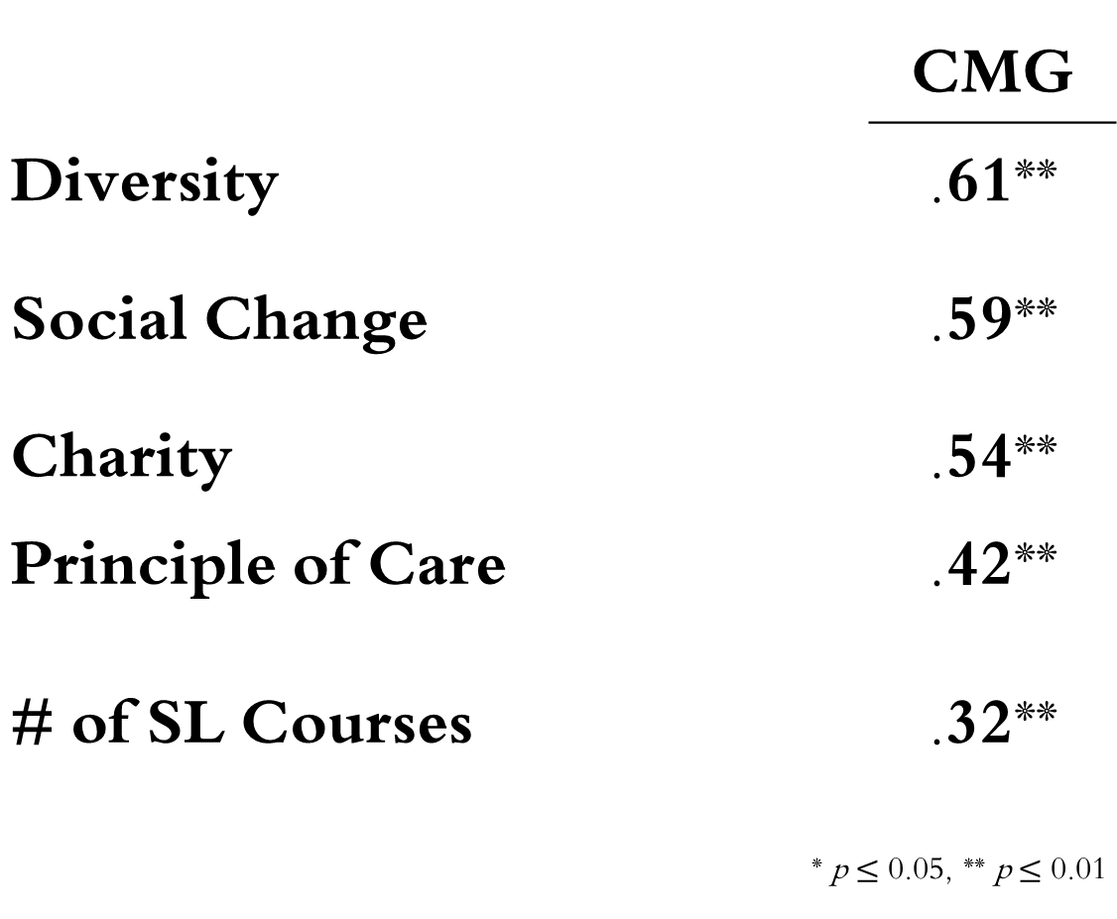
Bivariate Correlations
 | CMG
Diversity | .61**
Social Change | .59**
Charity | .54**
Principle of Care # of SL Courses | .42** .32**
* p $≤$ 0.05, ** p $≤$ 0.01

Slide 31
Stepwise Multiple Regression DV: CMG
Principle of Care cum R = .51**
Diversity
R = 35**
Social Change cum R = .49**
4th Step: # of SL course, cum R = .53**
* = p $≤$ .05, ** = p $≤$ .01

Slide 32
Study 4 (2014): Purpose
Further extend the construct validation of CMG to other components implied by the conceptual framework

Slide 33
Methods
Participants (n = 250) were from IUPUI
Questionnaire
Non-Prejudice: Universal Orientation Scale— “we” vs. “they” [split into + and -]
Charity vs. Social Change
Social Skills: Texas Social Behavior Inventory—self-reported social competence
Caring/Concern: Principle of Caring Scale
Quality of Life: Satisfaction With Life Scale

Slide 34
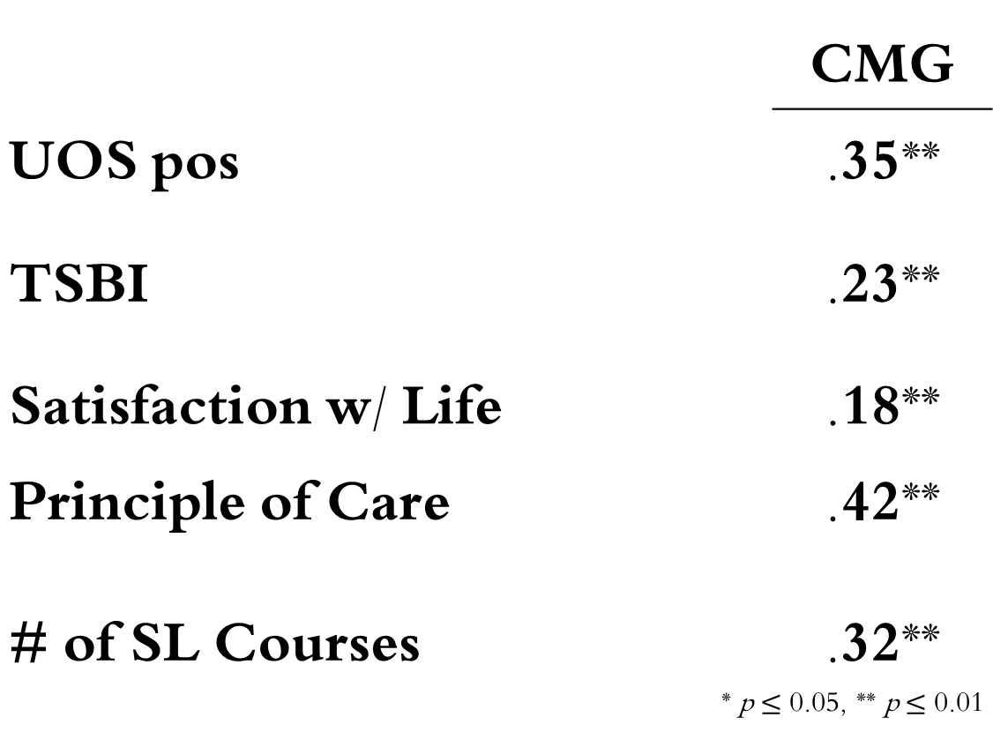
Bivariate Correlations
 | CMG
UOS pos | .35**
TSBI | .23**
Satisfaction w/ Life | .18**
Principle of Care # of SL Courses | .42** .32**
* p $≤$ 0.05, ** p $≤$ 0.01

Slide 35
Stepwise Multiple Regression DV: CMG
Sat w/ Life cum R = .41**
UOSpos
R = .34**
Social Skills cum R = .40**
* = p $≤$ .05, ** = p $≤$ .01

Slide 36
Knowledge:
√Volunteer opportunities: understanding of ways to contribute to society, particularly through voluntary service, and including knowledge of nonprofit organizations.
√ Academic knowledge and technical skills: understanding of how knowledge and skills in at least one discipline are relevant to addressing the issues in society.
• Contemporary social issues: understanding of current events and the complexity of issues in modern society locally, nationally, or globally.
Skills:
√ Communication and listening: ability to communicate (written and oral) with others, as well as listening to divergent points of view.
√ Diversity: understanding the importance of, and the ability to work with, others from diverse backgrounds; also appreciation of and sensitivity to diversity in a pluralistic society.
√ Consensus building: ability to work with others, including those with diverse opinions, and work across difference to come to an agreement or solve a problem.
Attitudes/Dispositions:
√ Valuing community engagement: understanding the importance of serving others, and being actively involved in communities to address social issues.
√ Self-efficacy: having a desire to take personal action, with a realistic view that the action will produce the desired results.
√ Social trustee of knowledge: feeling a sense of responsibility and commitment to use the knowledge gained in higher education to serve others.
Behavioral intentions:
√ A stated intention to be personally involved in community service in the future
Notes:
Example at IUPUI re: the triple intersection. RGB: will talk about the origin of this (“educationally meaningful service”) and the breadth of application (all SL courses + co-curricular)

Slide 37
Developmental Models
Deci and Ryan’s Self-Determination Theory
Intergroup Contact Hypothesis
Baxter-Magolda’s Self-Authorship and Learning Partnerships Models
Notes:
Deci and Ryan’s Self-Determination Theory, which provides a framework for examining the internalization of motivation
Intergroup contact hypothesis, which identifies the conditions under which interactions between individuals who are different can produce empathy, understanding, and more positive attitudes
Baxter-Magolda’s self-authorship and Learning Partnerships models that structure students experiences in college to develop self-authorship (i.e., internally constructed) and cognitive maturity that occurs when learners are intellectual partners with faculty and staff in activities related to civic growth.

Slide 38
Integration
The importance of interpersonal relationships to civic development and particular relationship qualities that are important
The importance of norms and expectations about the nature of the relationships
Connections to others (diverse others)
Cooperative relationships that have common goals (i.e., democratic)

Slide 39
Integration
Self-determination theory also:
provides an analysis of when the civic interest and motives will decrease due to experiences (e.g., extrinsic rewards, controlling circumstances)
suggests intervention strategies for those who lack internalized motivation

Slide 40
Across All Studies
Provides additional construct validity evidence about the nature of CMG
CMG related to a broad range of motives for service, functions of service, types of community involvement, skills
Related to service learning, but causality unclear
CMG is tapping integration of civic w/ identity

Slide 41
To What End/So What?
Improve CSL programs
Provides consistency of purpose across programs
Training sessions, applications, awards
“Civic Pathways Initiative” on ePortfolio
Improve SL courses and curriculum
Departmental grants to develop clear civic outcomes across curriculum; use and modify CMG tools
Faculty development workshops; reflection prompts

Slide 42
Uses of CMG
Program evaluation
Curricular: Service Learning Courses
Co-curricular programs:
Academic units (e.g., majors, departments)
Institutional assessment of civic outcomes
Represent civic engagement to external audiences
Research to understand change/growth

Slide 43
CMG: Not Just For Students
Students
5
1
10
Faculty
Administrators
4
9
2
6
8
7
Community Organization
Community Residents
3

Slide 44

Questions

