Slide 1
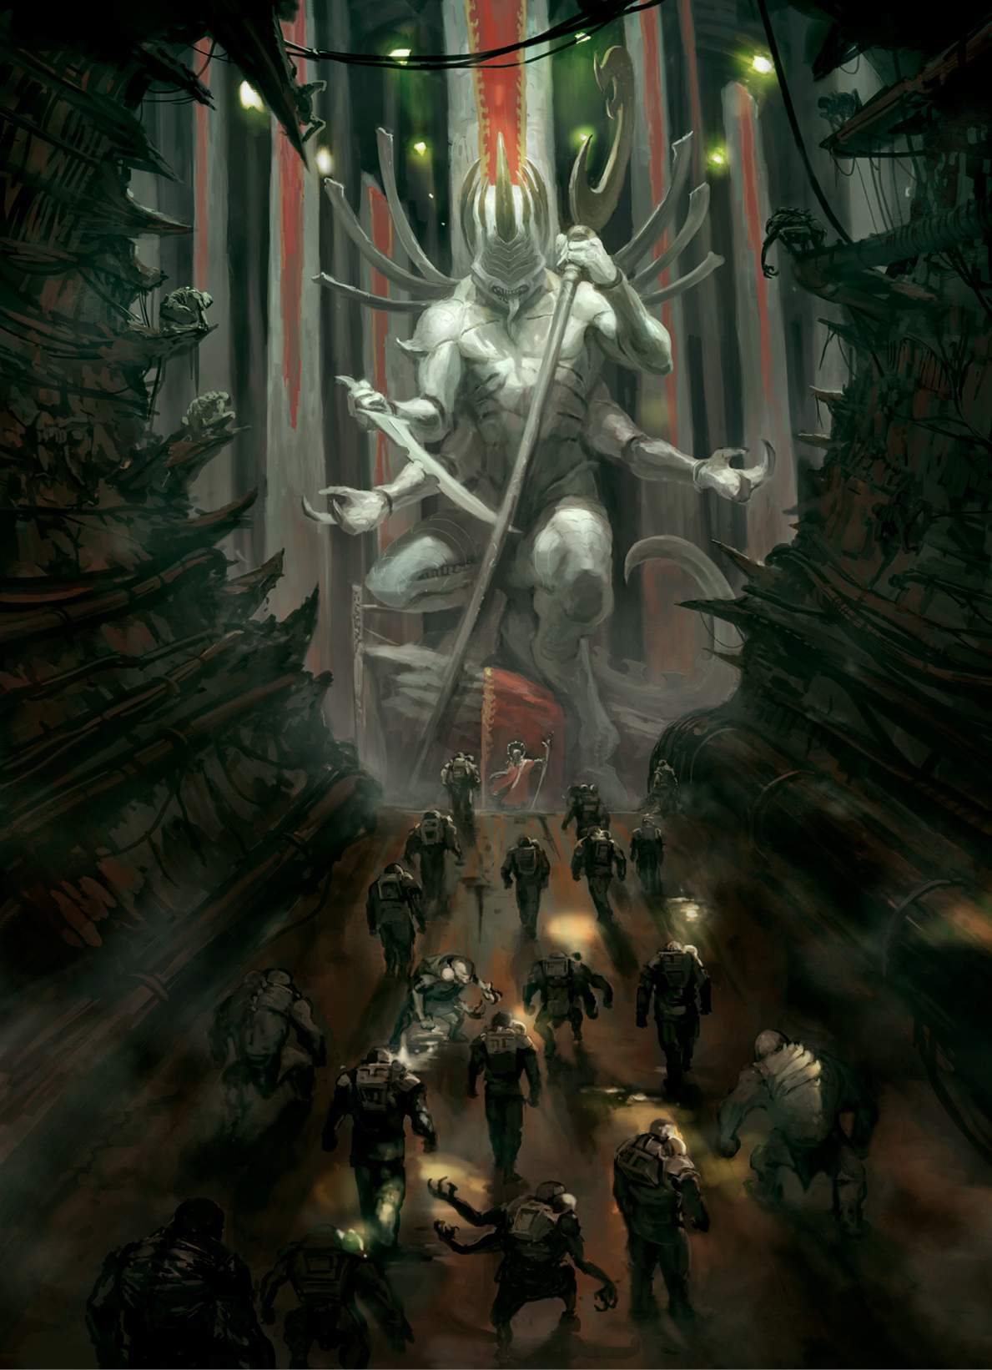
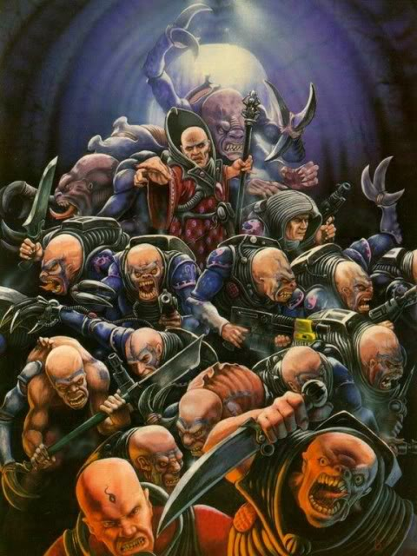

Millennialism and the Coming Tyranid Invasion
The Doomsday Beliefs of the Genestealer Cults
Notes:
A deadly pursuit? Dangerous ideas at the end of history - Bernard Doherty

Slide 2
Millennialism, Eschatology, and Doomsday Cults
The belief, expressed in the book of Revelation to John, the last book of the New Testament, that Christ will establish a 1,000-year reign of the saints on earth (the millennium) before the Last Judgment. (Brittanica) <or> The belief in a coming ideal society and especially one created by revolutionary action (Merriam-Webster)

Slide 3
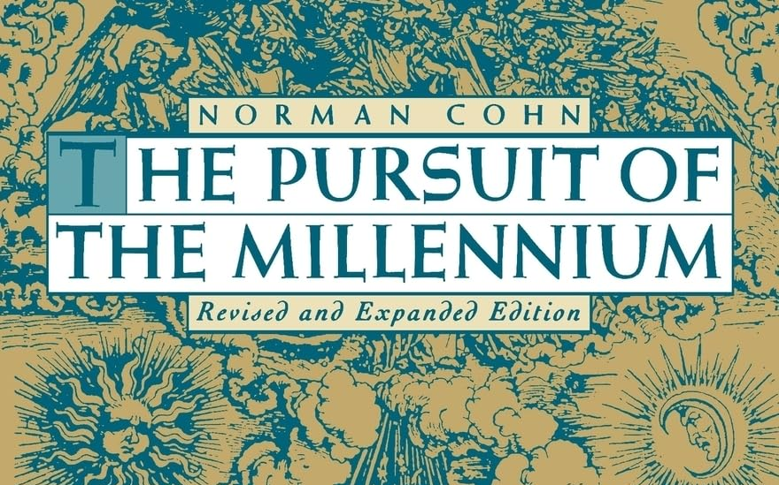
Belief Criteria for a Millennialism Religious Movement

Slide 4
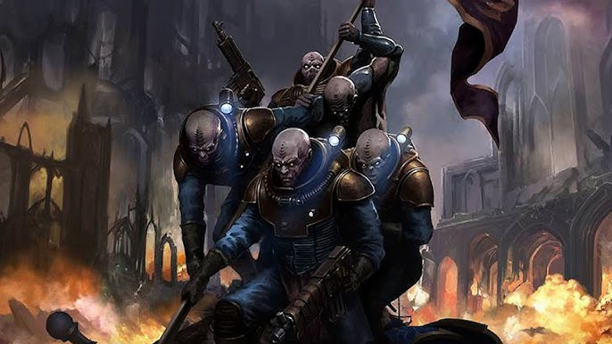
Collective, in the sense that it is to be enjoyed by the faithful as a collectivity
Notes:
Really this is most important in stressing that it is not an individual salvation. Rather it will affect society as a whole, and may include the damnation of non believers or those that lack the same zealotry as others. This criteria is of particular importance for the Genestealer Cults as they are now typically portrayed - as collective revolutionaries, borrowing the visual language of working class struggle. I want to highlight a presentation last year at this conference by Aasa Timonen and Ian Sturrock, Genestealer Cults and the Diverging Political Paradigm of Warhammer 40k, where-in they document the change of the Genestealer cults, from more “high society” style cult believers to the working class we’ve seen in the last few additions. This is reflected in the book, “Day of Ascension,” where the genestealers are the underclass on a world controlled by the Tech Priests of Mars.

Slide 5
Millennialism and Revolution
“On the one hand, revolution embodies the extreme side of socio political behavior, in the sense that through such a process humankind explicitly seeks to thoroughly and radically transform the institutions and values of a society. On the other hand, if we define ideology as a doctrine regarding the right and wrong ways in which social power and authority can be used and in what direction society should be headed, then millenarianism must be understood to be ideology in its most extreme form.”
Rinehart, pg. 2
Notes:
James Rinehart argues in his book Millennialism and Revolution that there is a link between the two movements, that a successful revolution may need the galvanizing forces of Millennialist beliefs.
Aasa Timonen and Ian Sturrock, Genestealer Cults and the Diverging Political Paradigm of Warhammer 40k

Slide 6
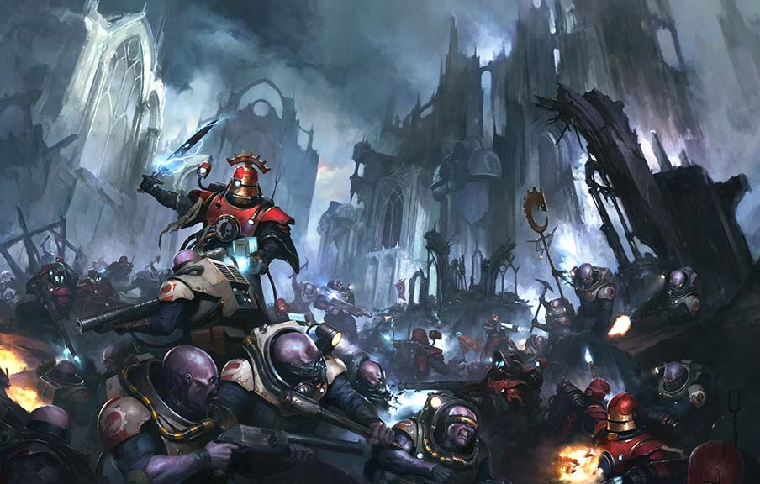
Three functions of Millennialism for Revolutionaries
A preparatory function
A leadership function
A therapeutic function
Notes:
Aasa Timonen and Ian Sturrock, Genestealer Cults and the Diverging Political Paradigm of Warhammer 40k

Slide 7
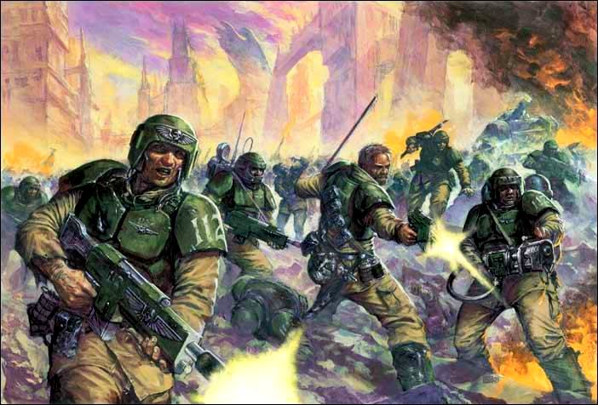
“The Disoriented Poor”
“...again and again, in situations of mass disorientation and anxiety, traditional beliefs about a future golden age or messianic kingdom came to serve as vehicles for social aspirations and animosities.”
Cohn, pg. 12
Notes:
From Pursuit of the Millennium from Norman Cohn

Slide 8
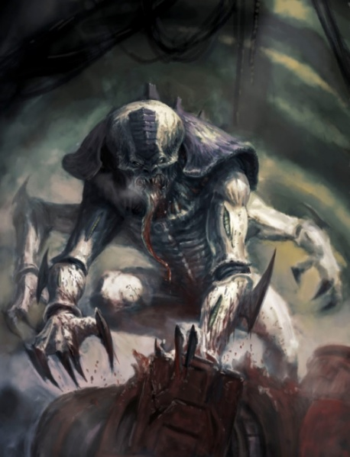
“The Disoriented Poor”
Broader Societal Upheaval
  Environmental
  Sociopolitical
  Economical
Mass Psychosis
“Brain Washing”
  Not a serious theory in study of NRMs

Slide 9
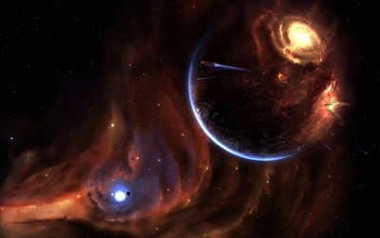
2. Terrestrial, in the sense that it is to be realized on this earth and not in some other-worldly heaven
Notes:
Genestealer beliefs do not extend past the planet that they are on. This makes sense from the Tyranid’s perspective, where the genestealers are used to whittle down a single planet’s defenses and act as a beacon for the swarm. It is curious tho, much like a geocentrist view of cosmology, that this means that the Genestealer’s don’t really discuss or think about the implications of their beliefs past the planet that they are currently inhabiting. While some talk of joining the star children is perhaps part of the genestealer belief, they are mainly concerned with the material conditions of their own planet and family.

Slide 10
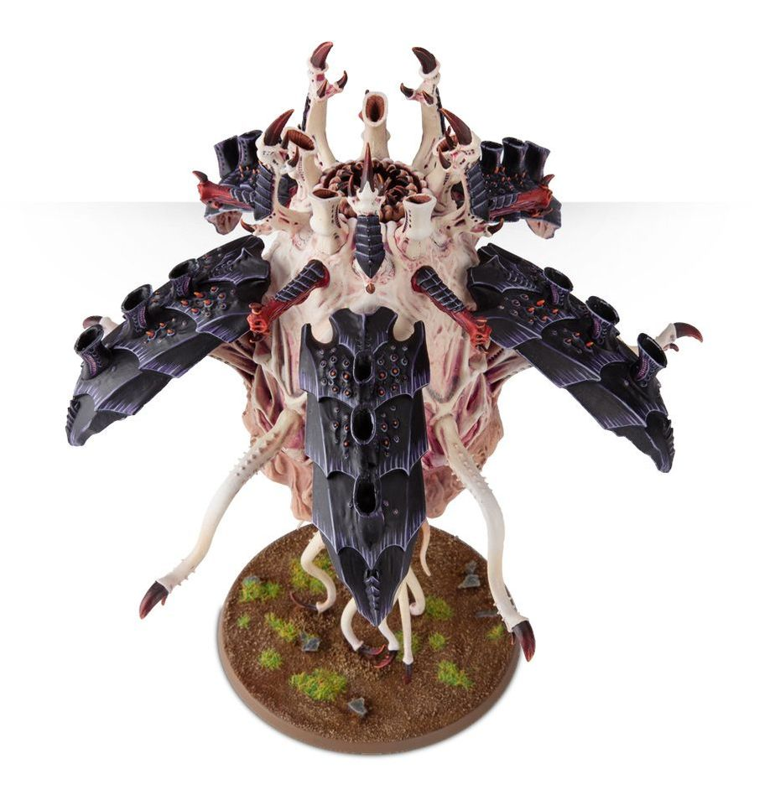
3. Imminent, in the sense that it is to come both soon and suddenly
‘It is not the time,’ she said again. ‘I listen, child. Every night I listen to the singing of the Emperor’s angels. They are closer, I know. They hear our hymns and know we are faithful, but it is not time, yet…’
- Tchaikovsky, pg 49

Slide 11
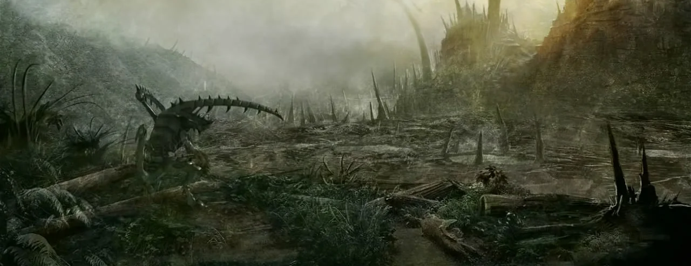
4. Total, in the sense that it is utterly to transform life on earth, so that the new dispensation will be no mere improvement on the present but perfection itself

Slide 12
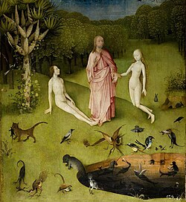
Return to Prehistoric/Idyllic State
‘I long for it,’ he said. ‘An end to work. An end to pain. A return to the arms of our blessed father. Isn’t that what we used to say when we were young?’
- Tchaikovsky, pg 141
Notes:
Nimrod built the Tower of Babel? Became associated with the first city builder, therefore the originator of private property. Both Genestealers and the Imperium religion believes in a return to a

Slide 13
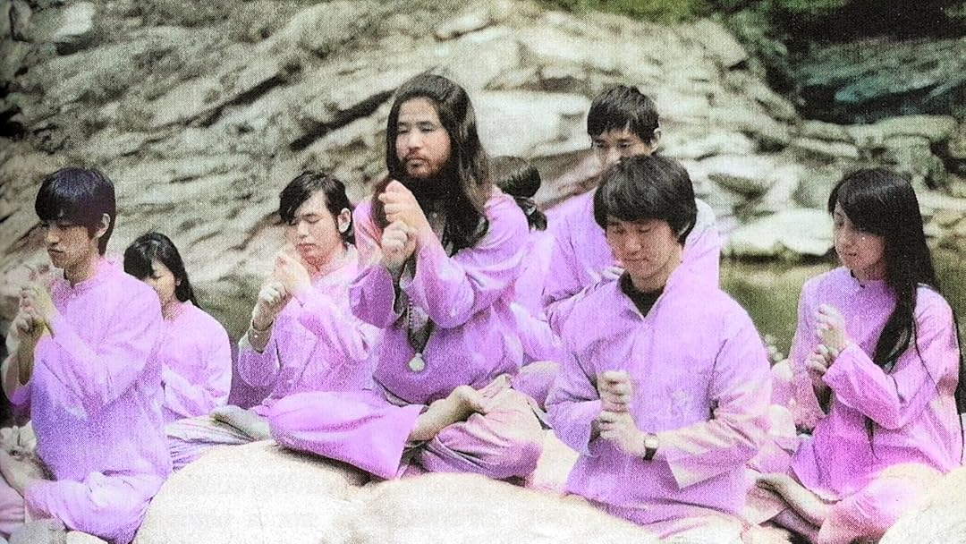
Dawn of New Society - Religious Members will Rule after Doomsday
Notes:
Aum Shinkrikyo believed in a nuclear war, where they will appear afteward to rule.

Slide 14
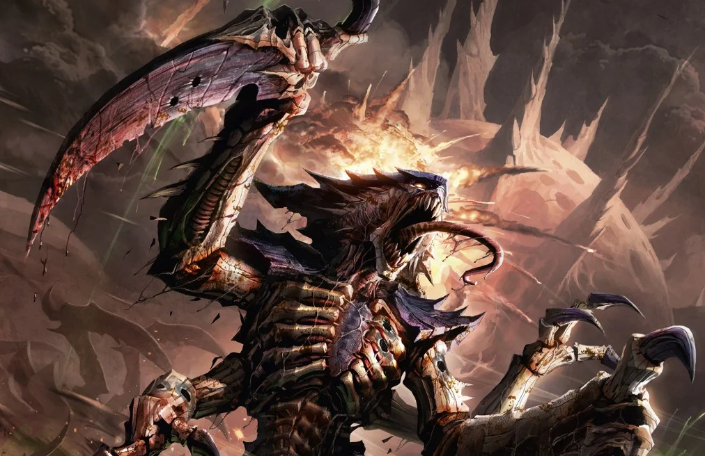
5. Miraculous, in the sense that it is to be accomplished by, or with the help of, supernatural agencies
You’re making a mistake,’ he told her hoarsely. ‘The things you want to call out to. They will
consume you. They’re not angels. They’re monsters.’
Her face was beatifically calm when she answered him. ‘What makes you think,’ she said, ‘that
they are two different things?’
- Tchaikovsky, pg 186-187
Notes:
They see the Tyranids as the “Star Children” or envoys of the 4 armed emperor, which will take them up and transform life.

Slide 15
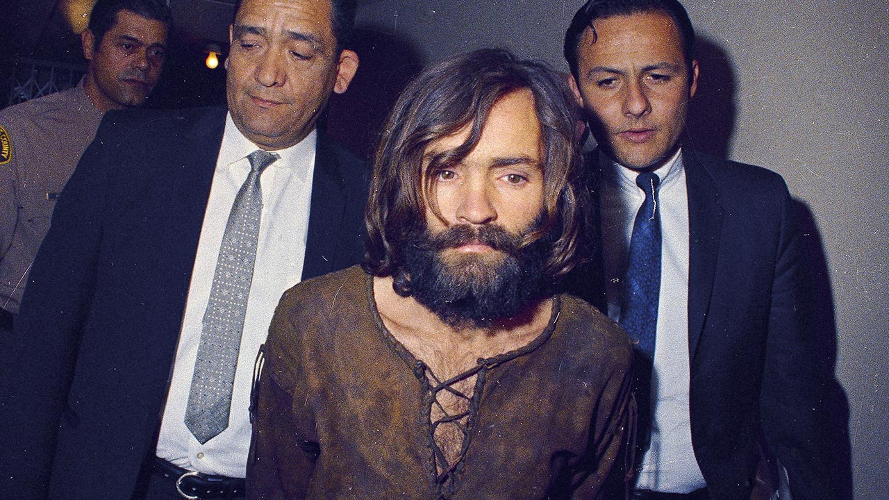
Secular “Miraculous Apocalypses”
Notes:
They see the Tyranids as the “Star Children” or envoys of the 4 armed emperor, which will take them up and transform life.

Slide 16
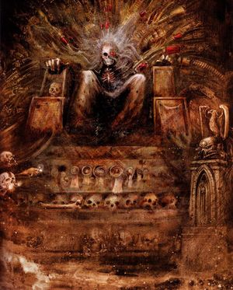
Heresy and Rebellion against Dominate Religion
Notes:
Catholic Church portrayed as the Whore of Babylon - a prophesied person or organization that heralds the end and helps the antichrist. It therefore becomes holy and necessary to kill clergy and nuns. Thomas Muntzer - "Omnia sunt communia"

Slide 17
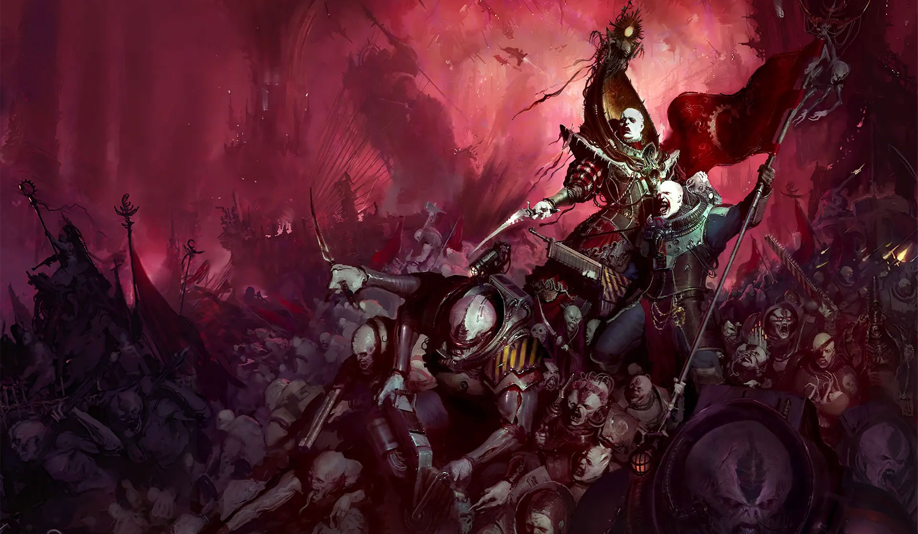
“The Cult Imaginary”
Notes:
THE CULT IMAGINARY: FRINGE RELIGIONS AND FAN CULTURES ON AMERICAN TELEVISION David Scott Diffrient

Slide 18
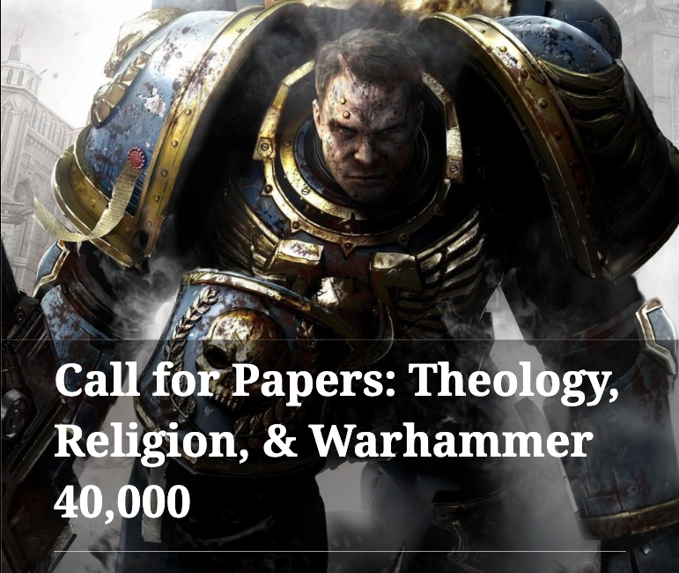

Gary R. Maixner III
gmaixner@iu.edu
Indiana University Indianapolis
Background image https://www.filterforge.com/filters/12725.html
Notes:
Thanks to Scott Harrower and Christopher Porter (eds) for

