Slide 1

Library publishing: we can’t do everything, so should we just quit?
Library Publishing Forum 2025
This work is licensed by the authors under CC BY 4.0
Notes:
OM

Slide 2
Agenda
Introductions
Polling component
Background
Research
Model
Wrap up & conclusions
Questions
Notes:
OM

Slide 3
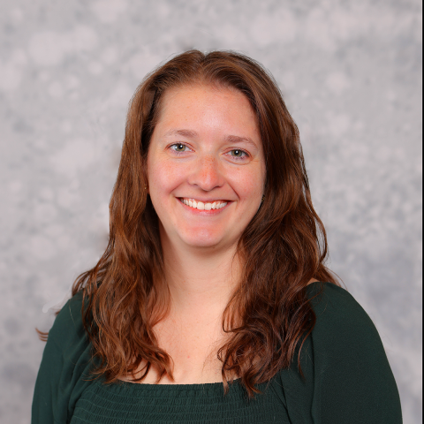
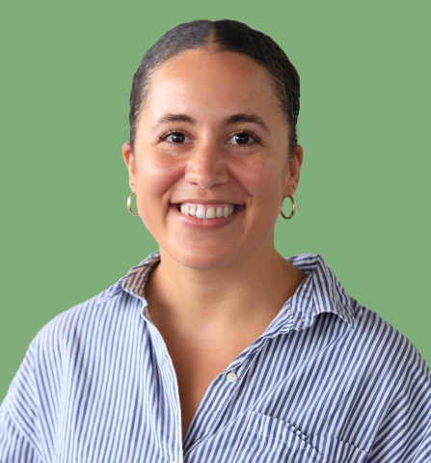
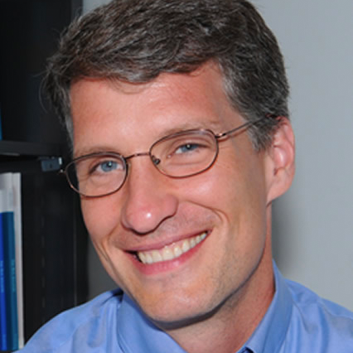
Presenter Information
Rachel Molina
Digital Publishing and Repository Librarian
ramolin@iu.edu
https://orcid.org/0009-0005-4918-1425
Olivia MacIsaac
Research Information Management Librarian
omacisaa@iu.edu
https://orcid.org/0000-0002-3870-6653
Jere Odell
Director, Center for Digital Scholarship
jdodell@iu.edu
https://orcid.org/0000-0001-5455-1471
Notes:
OM

Slide 4
Poll #1:
Why did you attend this session?
Notes:
Poll #1:
Q: Why did you attend this session?
A:
I’m ready to quit
I’m interested in doing less
I’m at my wits end
All of the above
Other

Slide 5
Background
Notes:
OM

Slide 6
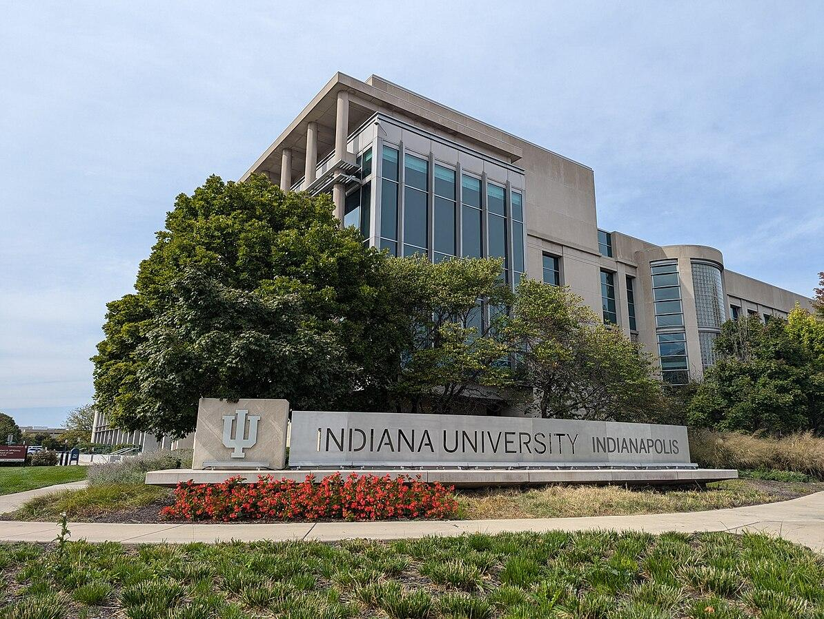
OA Journals at IU Indianapolis
Publishing activities began at IU Indianapolis (formerly IUPUI) in 2008
Hosting 27 journals using Open Journal Systems (OJS)
1 FTE and 4 individuals in the University Library contribute to program delivery
Indiana University Indianapolis entrance sign by Sbkb is licensed under CC BY-SA 4.0.
Notes:
OM

Slide 7
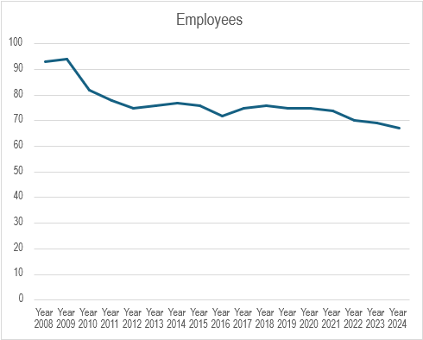
Increasing Workloads
Notes:
OM

Slide 8
Poll #2:
Are you operating with limited staff, budgets, and time?
Notes:
Poll #2:
Q: Are you operating with limited staff, budgets, and time?
A:
Yes.
No, library publishing at my institution is highly valued and the budget goes up every year.
I don’t really know.

Slide 9
Research
Notes:
RM

Slide 10
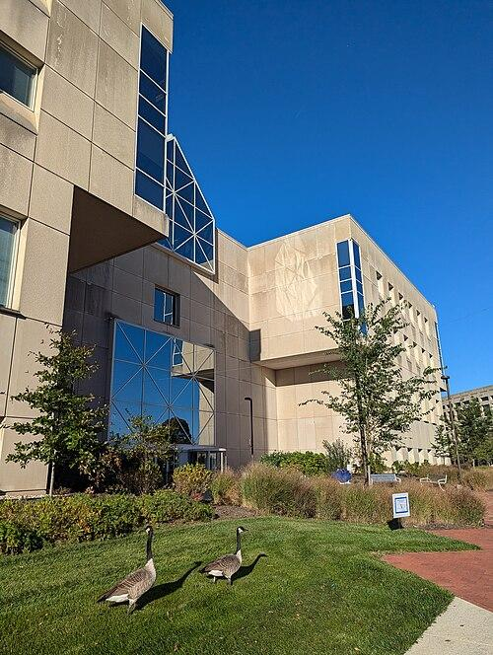
Environmental Scan
SPARC Open Investment Statements and Principles
Open values statements of comparable institutions
LPC’s “An Ethical Framework for Library Publishing Version 2.0”
Calculation of costs
IUI University Library with Canada Geese by MSwierenga is licensed under CC BY-SA 4.0.
Notes:
RM
We began our research with an environmental scan, including looking at the SPARC Open Investment Statements and Principles repository, the LPC Ethical Framework for Library Publishing 2.0, and our own publication costs versus our current estimated budget.

Slide 11

Comparison of Similar Institutions
From SPARC repository: Montana State University, Iowa State University, University of British Columbia, Ohio State University
Common OA policy themes:
Policy/financial transparency
Scholar-led
Digital preservation strategy
Mission/values driven
Interoperable/discoverable
Meets legal accessibility standards
Notes:
RM
When reviewing example open access policies and value statements, we focused on looking at similarly sized institutions listed on the SPARC repository including Montana State, Iowa State, the University of British Columbia, and Ohio State. The common themes found in each of these institutions’ open access statements included: policy and financial transparency, being scholar-led, having a digital preservation strategy, being mission or values driven, being interoperable and discoverable online, and meeting legal accessibility standards.

Slide 12
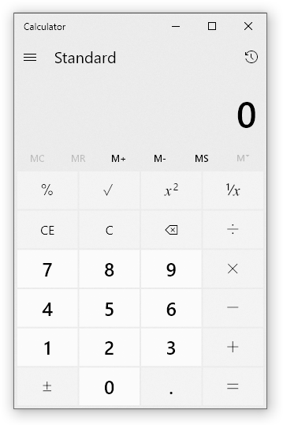
Calculating Costs
Operating budget estimate
Labor- > $30,000/year between 5 people
Server space- ~$900/year
DOIs (via Crossref)- $270 in 2020
LPC membership- $2000 in 2020
PKP- $1000 in 2020
Calculator program on Windows 10 by Microsoft is licensed under MIT/Expat License.
Notes:
RM
The final piece of our research before creating our model was to calculate our own institutional costs compared to our current estimated publishing budget. This includes the cost of labor in time, amount of server space used, and the monetary cost of listing DOIs via Crossref, our institutional LPC membership, and the cost of the PKP module. Our labor estimated cost is over $30,000 a year between five people. In hours, four out of five of us spend between 5-10% of our time working with OJS. I’m the remaining person and while I haven’t been here for publication for most of our journals just yet, I’m estimating that OJS will probably take up about 40% of my time when all is said and done. The cost of maintaining our server space is roughly $900 a year. We spent approximately $270 on the Crossref plugin to integrate DOIs in our OJS instance in 2020. It can be assumed that cost has remained relatively constant over the past five years. Our institutional membership with LPC was $2000 in 2020, giving us access to this forum and its resources. Again, this cost can be assumed to have remained the same. Finally, our PKP plugin for OJS cost $1000 in 2020. Unfortunately, this plugin has not worked for some time, meaning this is extra money wasted until we can get it working again. Andy- 4-6 hours/month
Lucy- 15 hours/year
Rachel- 40% OJS, 60% SW??
Olivia- ~10%
Jere- ~5% Olivia: about 2.83 hours/month or 10% of overall time, and $5,728.90 (but these are just very rough estimates) 40% of my time is about $22,720 (I think)

Slide 13
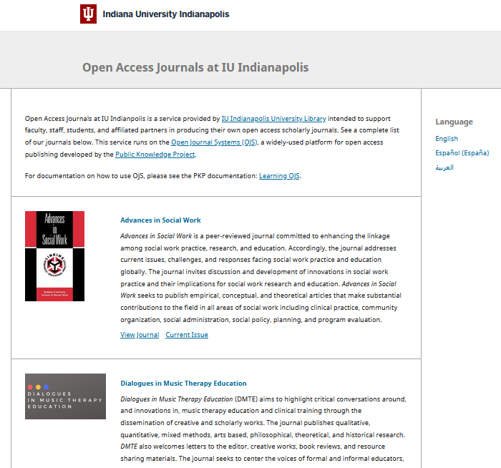
Journal Audit
Scan of current list of journals
Activity status
Publication frequency
DOI/ORCID integration
Use of peer review
Use of OJS publishing workflow
Notes:
OM
In order to figure out a starting point for evaluating our digital publishing platform, we conducted a brief internal audit of the journals currently hosted on our OJS instance. This included noting activity status, publishing frequency, DOI and ORCID use, peer review use, and whether the journals used the OJS publishing workflow. The original audit of our journals was conducted in 2021, so there were a few updates to make regarding the number of journals that were still active.

Slide 14
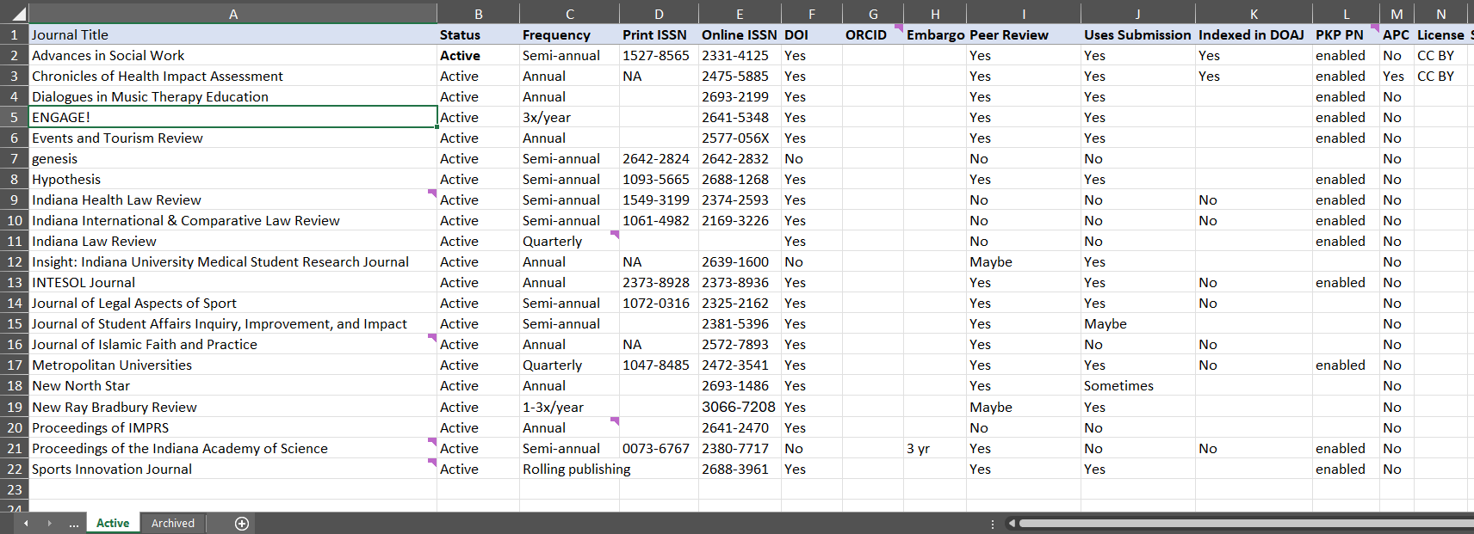
Audit Results
21 active journals
Frequency: 8 annual, 8 semi-annual, 2 quarterly, 3 on rolling basis
OJS submission workflow: 12 use, 2 partial use, 7 do not use
DOI plugin: 19 use, 3 do not use
6 inactive/archived journals
3 journals recently moved from active to archived due to over 2 years of inactivity
2 journals on OJS as archives
1 journal that ceased publication in 2016
3 pending new journals (as of March 2025)
Notes:
OM
The results of our journal audit are as follows. We currently have 21 active journals. Of those, 8 publish annually, 8 publish semi annually, 2 publish quarterly, and 3 publish on a rolling basis. 12 of these journals use the OJS submission workflow in its entirety, with 2 using only some of the workflow and 7 not using the workflow at all. 19 of these journals currently use DOIs through Crossref while three do not. It’s important to note that those three without DOIs are law reviews, which historically don’t use DOIs anyway. We currently have 6 inactive or archived journals. Before this audit, that number was three; we moved 3 journals to inactive/archived status due to over two years of inactivity. As of March of this year, we have three pending new journals. Two of these were pending before this audit, and one has been added after implementation of our new model.

Slide 15
Poll # 3:
Does your library publishing program follow the Ethical Framework for Library Publishing 2.0?
Notes:
Poll #3:
Q: Does your library publishing program follow the Ethical Framework for Library Publishing 2.0?
A:
To a T
Somewhat
I don’t know what you’re talking about?

Slide 16
Model
Notes:
RM

Slide 17
Re-examining our values
Abridged Version of our Open Values Statement
allow the re-use and re-design of their work by the public through open licensing.
In other words: CC BY, CC BY SA, CC BY NC
access to and creation of resources should be available to all regardless of education level, geographic location, organizational affiliation, socioeconomic status, and traditionally disadvantaged groups in alignment with the UL Diversity Statement.
we support our community and invest our resources in our institution and its unique content and research strengths
increasing the visibility of IU Indianapolis research and central Indiana history
creating opportunities for innovative learning and scholarship
will be transparent in our work
Notes:
Add joy to Open Values Statement as it pertains to library staff
Notes:
OM
Relates to 1.1 in the Ethical Framework for Library Publishing 2.0
Our model begins with a re-examination of our values, starting with our open values statement, linked in the slide. An abridged version of our open values statement is as follows: allow the re-use and re-design of their work by the public through open licensing, i.e. Creative Commons licenses. We believe access to and creation of resources should be available to all regardless of education level, geographic location, organizational affiliation, socioeconomic status, and traditionally disadvantaged groups in alignment with the UL Diversity Statement. We support our community and invest our resources in our institution and its unique content and research strengths. We are committed to increasing the visibility of IU Indianapolis research and central Indiana history. We focus on creating opportunities for innovative learning and scholarship. And finally, we will be transparent in our work.

Slide 18

Update Terms of Agreement
Last updated in 2021, pre-IU/Purdue split
In addition to updating brand language, we also looked at updating technical language to realign with open access values
Decision to re-sign terms of agreement every five years
Notes:
RM
The last time we had journals sign our terms of agreement was in 2021. Due to institutional changes in the past academic year, it was necessary to at minimum rewrite our terms of agreement with updated language to make it current with IU Indianapolis brand guidelines. Because we were already editing the terms and will need our journals to resign the new version, we decided to also look at the technical language of the document to make sure it still aligned with University LIbrary values and our open access mission. We also determined that terms of agreement need to be resigned by each journal every five years to make sure both parties are following the agreement over time.

Slide 19

Editor Survey
Survey via Qualtrics sent to all journal editors/contacts asking for feedback on the OJS workflow and the library’s publishing support
Doubled as a new librarian introduction
Notes:
RM
In addition to our internal journal audit, we decided to check in with editors of our journals to see how they were feeling about both OJS and our library’s support of their publications. This survey was based on a previous editor survey from 2022. Because I was new to my role at the start of this project, I took this as an opportunity to introduce myself to the editors as well. I framed this survey in the light of making sure I met everyone and had a solid baseline to work from when taking over my role, knowing what expectations there were as far as service, and establishing a communication line for future questions.

Slide 20
Survey Results
Use of peer review:
9 yes, 1 no.
Use OJS workflow: 5
Use something outside OJS: 4
Use of OJS submission workflow:
6 yes, 4 no
Other forms of submission include: email, Scholastica, Submittable
Sponsored by what type of organization?
Academic unit (e.g. school, department): 5
Scholarly society: 2
Other: 3
10 Responders (48%):
Journal role: 9 editors, 1 managing editor
5 faculty, 3 staff, 2 student
Notes:
RM
Our journal survey received 10 responses out of 24 journals. A reminder that before this survey, three of these journals were technically inactive without being officially moved to that category, meaning our response rate was roughly 48%. This is about the same as when my predecessor conducted a survey in 2022. Of the 10 responses, 9 of them identified themselves as editors while one identified as a managing editor. 5 of the respondents were faculty, 3 were staff, and 2 were students. When asked about their use of peer review, 9 respondents said they do use peer review while one did not. Of the 9 that use peer review, 5 of them conducted it through OJS while 4 used something else. When asked about their use of the OJS submission workflow, 6 respondents said they use it while 4 said they use something else. Other forms of submission include via email, Scholastica, Submittable, or a combination of those three. When asked what kind of organization sponsors the work of the journal, 5 said an academic unit, 2 said a scholarly society, and three said other. Those who said other are sponsored by a non-academic office and other outside scholarship hubs.

Slide 21

Survey Results
Type of compensation
Voluntary: 4
Stipend: 2
Part of normal job-related duties: 3
Course release: 1
Level of satisfaction with OJS
Extremely satisfied: 4
Somewhat satisfied: 4
Somewhat dissatisfied: 2
Level of satisfaction with library support
Extremely satisfied: 8
Somewhat satisfied: 1
Neutral: 1
Notes:
RM
When asked about the type of compensation they receive for their journal work, 4 said it was voluntary; 2 work on the journal via stipend; 3 have this work included as part of their job; and 1 was working on the journal as part of a course release. When asked about their satisfaction with the OJS workflow, the respondents were split between being extremely satisfied and somewhat satisfied, with only two being somewhat dissatisfied. Comments on the OJS workflow included: while OJS is quirky, they’ve learned to work with it; they’d like to learn more about the built in features but haven’t had the time; frustration with the the system being “clunky” or uneasy to navigate; and issues with emails and the ability to log in.
When asked about their level of satisfaction with library support of their publication, most respondents were extremely satisfied, with one being somewhat satisfied and one being neutral. The neutral respondent noted that they miss my predecessor, who left about a year before I took this position. Comments about their level of satisfaction included that the library team is very responsive and friendly.

Slide 22

Survey Results
Reason for publishing with University Library
Free or low-cost option
Digital repository/preservation
Legacy
Ranked most important:
Preservation of scholarship: 3
Ease of digital publishing: 1
Readers having free access to scholarship: 4
Efficient editorial workflow: 1
Ranked least important:
Preservation of scholarship: 2
Ease of digital publishing: 1
Efficient editorial workflow: 6
Notes:
RM
When asked about the reasons these journals chose to publish with us, most respondents noted either enjoying the free/no cost option, wanting some kind of digital preservation of their work, or inheriting the journal from someone else who made the decision and leaving it in place. Finally, we asked the journal editors to rank the following factors influencing their open access publishing decisions from most to least important: preservation of scholarship; ease of digital publishing; readers having free access to scholarship; and having an efficient editorial workflow. The majority of respondents said that either preservation of scholarship or readers having free access was the most important. Almost all respondents agreed that the editorial workflow being efficient was the least important factor for their decision. Having the majority of the respondents choose knowledge access over ease of work is an encouraging trend, especially as we move forward double checking that our open publishing program aligns with our open access values.

Slide 23
Poll #4:
How do you evaluate your library publishing program?
Notes:
Poll #4:
Q: How do you evaluate your library publishing program?
A:
Surveys/questionnaires
Rubrics
Decision trees
Focus groups
Observations
I don’t

Slide 24
Evaluating active journals
Basic rubric for evaluating criteria
Four general categories
Values-based
Diversity
Community oriented
Available to all
Add up points for overall score, but allow room for subjective opinion
Notes:
RM
Because the main point of this model is to make sure the library is not overextending itself in its library publishing efforts, it was necessary to create guidelines for when to offload active journals. We created a rubric in order to grade our current list of journals and their alignment with our institutional values. The rubric is divided into the following point categories: exceeds expectations, meets expectations, approaching expectations, not yet meeting expectations, and not applicable. The decision to offload, or in our case archive, an active journal can be made based on how the journal scores using this rubric. Ultimately that decision needs to be up to the librarian grading the journal, though. For example, if a journal scores excellent in three categories but needs improvement in one, that one low score would probably not be reason enough to offload the journal. Similarly if the editors of the journal in question are easy to contact or work with and are willing to put in effort to improve their journal to meet these criteria, the journal could remain in the system. In the end, it will be up to the librarian as to whether a journal gets offloaded or gets a second chance.

Slide 25
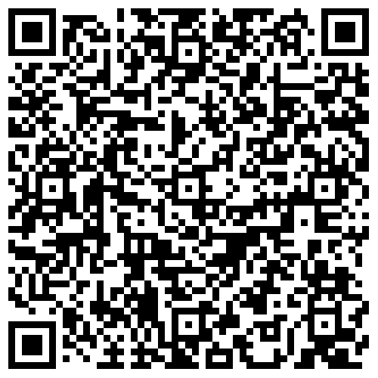
Journal Evaluation Rubric
https://tinyurl.com/bhwzbxpm
Use the QR Code or link to view the evaluation rubric in Excel
Notes:
RM
We’ve made our rubric available to you through this qr code and through the tiny url linked here. You’re welcome to take a moment and check out the rubric for yourselves, and feel free to download now or later to use for your own publishing workflows.

Slide 26
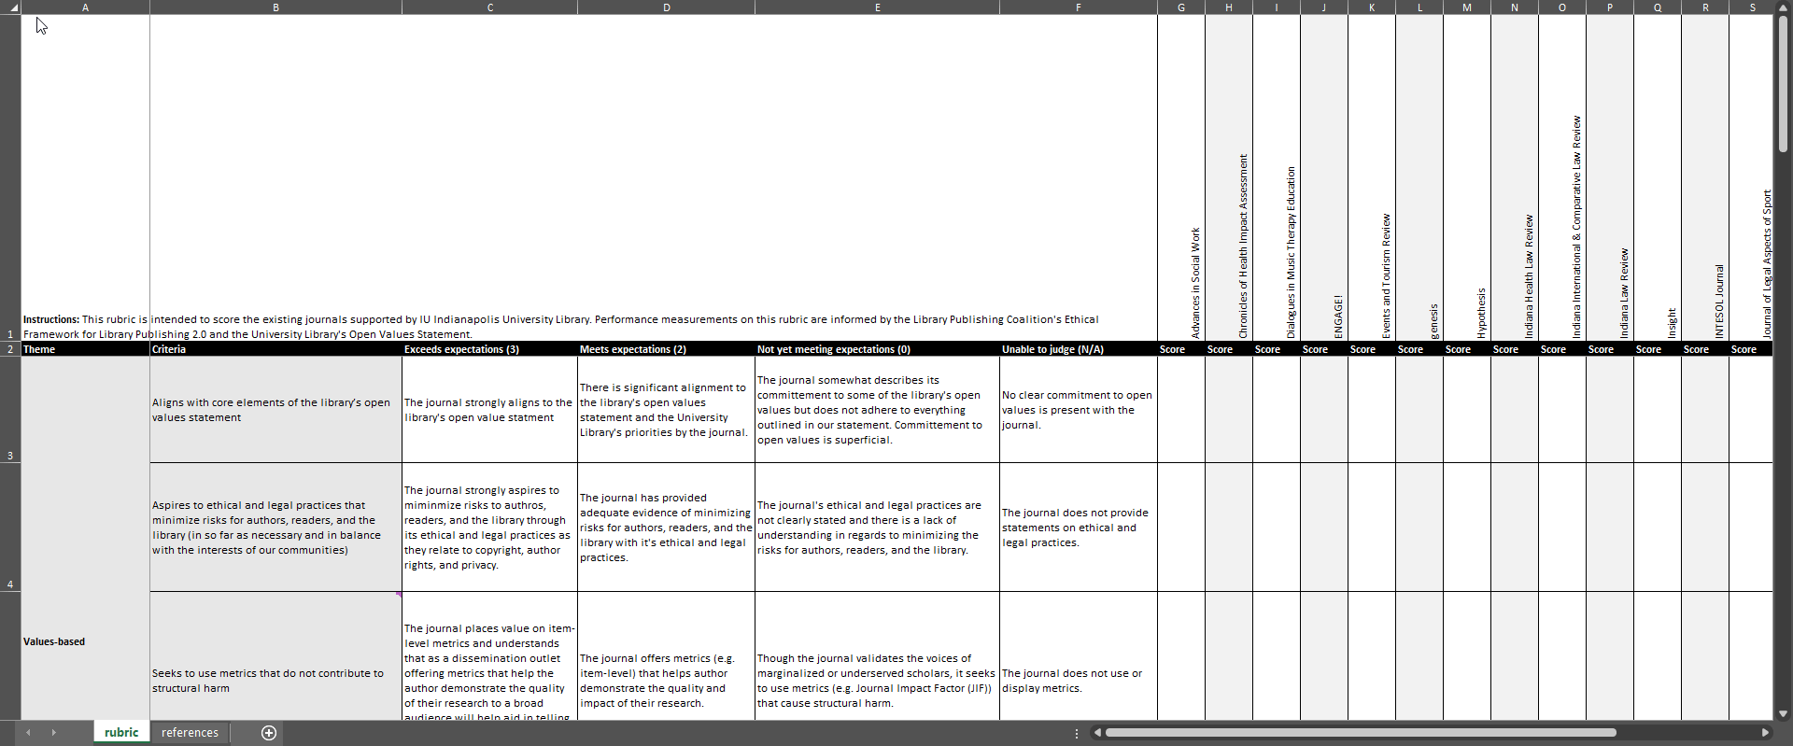
Journal Evaluation Rubric
Divided into four LPC Framework categories
Three possible points, allows for N/A
Lists every journal to compare scores
Notes:
RM
Here you can see a gif of our evaluation rubric. We’ve color coded the rubric for each of the four LPC framework categories. Each category has separate line items that can be valued up to three points, with an option for not applicable in certain cases. We’ve listed every active journal in order to compare scores.

Slide 27
Testing the rubric: how will this work with potential new journals?
Used rubric as a test run on three hosted journals, with varying results
Some questions/insights brought up during our evaluation:
What to do with a journal that doesn’t use metrics?
How much does one person on the editorial team weigh against the journal itself?
How are we supposed to know how they treat each other (community oriented)?
How to evaluate if we haven’t dealt with them yet (i.e. since starting the position)
Notes:
RM
After developing this rubric, we tested it with three of our active journals and got varying results. The journals included a fully institutional journal through one of our schools, an outside journal related to the university through faculty, and a student-led creative works journal. At the moment, the highest a journal can score on our rubric is 39. The tested journals each scored: 27 for the institutional journal; 19 for the outside journal; and 15 for the student journal. While their scores were widely varied between categories, all three journals scored 0 for accessibility- an issue that we are hoping to address before the new ADA requirements for web materials take effect next April. The outside journal scored a mix of 1s and 2s across the board, while the institutional journal scored 3s in most categories besides their cooperativity with us. A partial reason for the student journal scoring so low is that I was unable to score them in many categories, since I haven’t experienced publishing with them yet. Many questions and insights were brought up during our test evaluation with our rubric including: what do we do with a journal that doesn’t use metrics? How much does one difficult person on an editorial team weigh against the journal itself? How are we supposed to know how they treat each other during the publication process, one of the community oriented guidelines? And how are we supposed to evaluate a journal if we haven’t dealt with them publishing yet? That last one is mostly for me, since the majority of our journals haven’t published since I started this position. Because of some of these questions, we decided to include the “not applicable” category for journals so that their scores aren’t negatively affected. In this case, you could subtract 3 points for each N/A used from the total of 39 to get a more accurate score.

Slide 28
Guidelines for taking on new journals
Decision tree to help guide process
Will they be uploading and publishing on their own?
Will they use the OJS workflow or something else?
How much support from the library will they need (i.e. time spent by faculty/staff)
Are they connected to the university at all? If not, are they connected to a scholarly society?
Are they financially transparent?
Do their values/policies align with the library’s?
Allow room for subjective opinion
Notes:
RM
Moving on to the guidelines created for taking on new journals, we decided a decision tree would be most helpful in increasing our publishing output while also making sure we are not overextending our resources. The decision tree would include questions like: will they be uploading and publishing on their own? Will they be using the OJS workflow or something else? How much time will the support of their journal require from our faculty and staff? Are they connected to the university at all? If not, are they connected to a scholarly society? Are they financially transparent? Do their values and policies align with ours? Working your way through this decision tree and weighing answers based on your institution’s open values statements will help in deciding whether to take on that new journal or to pass. Just like with offloading old journals, though, the end decision will ultimately lie with how the librarian feels.

Slide 29
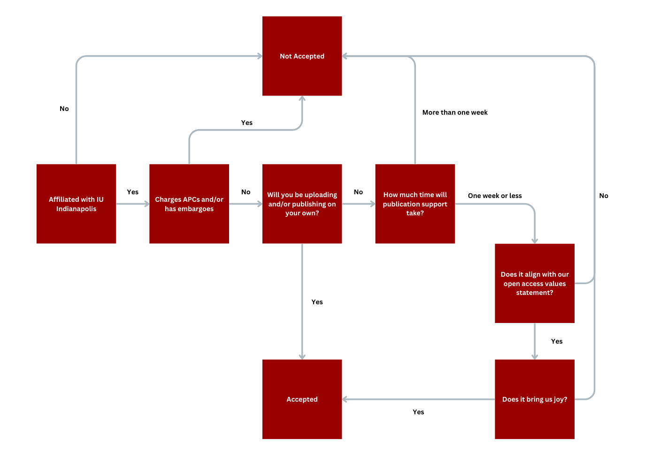
New Journal Decision Tree
Notes:
RM
Walk through the decision tree

Slide 30
Testing the decision tree with new journals
Prior to taking this position, previous librarian took on two new journals (pending)
Using decision tree, we’ve taken on one new journal since this project*
Prioritizing institution connections
Updated terms of agreement mean no more accepting of embargoes or APCs
Notes:
RM
Before my predecessor left, he accepted two new journals into our publishing program. As of right now, both are still listed as pending, with no first publication date set. After taking my position, I have accepted one more new journal before creating this model. Word being forced to take on crossroads somehow. In creating this model, we decided to prioritize institutional connections, meaning moving forward we will only accept journals that are made by someone who is based at IU Indianapolis. Because of our already heavy workload, this will hopefully help us not get overwhelmed while also helping us focus on building up our community. We also updated our terms of agreement by taking out the language that allowed for a two year embargo if absolutely necessary. Moving forward, we will not allow embargoes from any of our journals, hoping to encourage more full open access research.

Slide 31
Example journal evaluation
Example journal evaluation
Journal 1:
Affiliated with IU: yes
Charges APCs: no
Uploading / publishing on their own: no
More than 40 hours FTE*
Do not accept
Journal 2:
Affiliated with IU: yes
Charges APCs: no
Uploading / publishing on their own: yes
Accept
Notes:
Here is the decision tree, starting with whether the journal is affiliated with IU. We move to whether it charges APCs, whether they’ll be uploading and/or publishing on their own. If they will be doing the work themselves, we’ll accept the journal. If we will be helping them upload and/or publish, we’ll calculate how much time we anticipate needing for support of those workflows. If the amount of time is acceptable for our current workload, we then check to see if it aligns with our open access values statement. Finally, if everything else looks good, we ask if it will bring us joy- is it something we can happily support? If yes, then the journal is accepted. Let’s go through a couple examples using our decision tree with two hypothetical new journals. Journal one is affiliated with IU, so we will consider it for publication. It doesn’t charge APCs, which is in line with the terms of agreement. They don’t plan on uploading and/or publishing on their own, which means we will have to commit time to upload and publish for them. When looking at their publication, it appears that it will take more than 40 hours of FTE in order to get it uploaded and published. Because of the amount of time it will need from us, we decide to not accept this journal. A note about this: we’ve roughly estimated 40 hours FTE for the purposes of this model, but will need further time studies to actually see how long certain journals take. Because I’m so new and haven’t experienced all our journals publishing issues yet, I can’t say with certainty how long this work actually takes. Journal two is also affiliated with IU and doesn’t charge APCs, but they plan on either uploading, publishing, or both on their own through the OJS workflow. Because the amount of time it will take for us to support this journal appears to be minimal, we decide to accept and publish this journal.

Slide 32
Poll #5:
How comfortable are you with letting things go?
Notes:
Poll #6
Q: How comfortable are you with letting things go?
A:
“I’ll never let go” - Rose (Titanic, 1997)
“Let it go” - Elsa (Frozen, 2013)
Undetermined

Slide 33
Wrap up & conclusions
If you’re doing too much, it’s time to prioritize
Don’t be afraid of saying no
Remember to make sure you leave room for joy
Notes:
OM

Slide 34
Questions?
Notes:
OM facilitates [15 min]
If anyone asks about DEI: Indiana is a red state, the state legislature is trying to get us to roll back DEI initiatives and statements but the university library is committed to keeping our values, even if we have to rename them (?)
How are we leaving room for joy?
Brainstorming joy:
OM: connections with people
OM: mentoring students involved with library publishing
RM: uplifting underrepresented voices, increasing general knowledge and literacy
JO: contributing to meaningful project with people I value; surviving this bullshit together (eg, with Olivia and Rachel)

Slide 35
References
Agate, N., Beamer, J., Bedford, E., Boczar, J., Bjork, K., Guimont, C., Harmon, I., Hunter, M., Johnson, A., Wipperman, S., Gabler, V., & Schlosser, M. (2020). Library Publishing Research Agenda. Added the Accessible File with the Corrected Cover. https://doi.org/10.5703/1288284317124
Baich, T., Collins, N., Ding, J., Guyla, A., Wake Hyde, Z., Lear, B., Neds-Fox, J., Roh, C., Schlosser, M., Shuttleworth, K., & Turner, C. (2023). An Ethical Framework for Library Publishing Version 2.0. Purdue University. https://doi.org/10.5703/1288284317619
Brown, A., Cole, E., Ho, A., Hurford, A., Kowalski, M., Laird, A., Lange, J., Soper, D., Syma, C., Polley, T., Fruin, C., & Schlosser, M. (2020). Library Publishing Competencies. LPC Publications. https://doi.org/10.5703/1288284317123
Open Investment Statements and Principles. (n.d.). SPARC. Retrieved February 5, 2025, from https://sparcopen.org/our-work/negotiation-resources/strategic-priorities-working-group/open-investment-statements-and-principles/
Unit 2: Narrative. (2019, October 31). Educopia. https://docs.google.com/document/d/1yMaS_qzRbB37B2jfhAbg-zL0wzwNwbP9YIYi4EOSprk/edit?usp=sharing&usp=embed_facebook

